Slide 1
Operating System

Slide 2
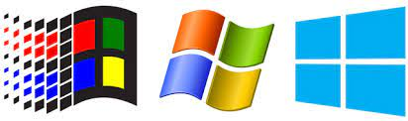
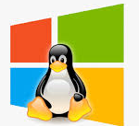


What is an Operating System?
A program that acts as an intermediary between a user of a computer and the computer hardware.
Operating system goals:
Execute user programs and make solving user problems easier.
Make the computer system convenient to use.
Use the computer hardware in an efficient manner.

Slide 3
Computer System Structure
Computer system can be divided into four components
Hardware – provides basic computing resources
CPU, memory, I/O devices
Operating system
Controls and coordinates use of hardware among various applications and users
Application programs – define the ways in which the system resources are used to solve the computing problems of the users
Word processors, compilers, web browsers, database systems, video games
Users
People, machines, other computers

Slide 4
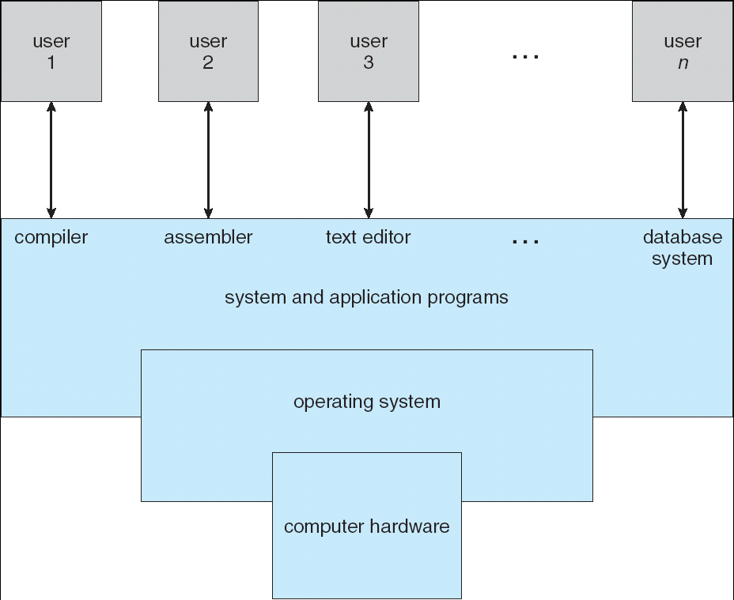
Four Components of a Computer System

Slide 5
What Operating Systems Do
Depends on the point of view
Users want convenience, ease of use and good performance
Don’t care about resource utilization
But shared computer such as mainframe or minicomputer must keep all users happy
Users of dedicate systems such as workstations have dedicated resources but frequently use shared resources from servers
Handheld computers are resource poor, optimized for usability and battery life
Some computers have little or no user interface, such as embedded computers in devices and automobiles

Slide 6
Operating System Definition
OS is a resource allocator
Manages all resources
Decides between conflicting requests for efficient and fair resource use
OS is a control program
Controls execution of programs to prevent errors and improper use of the computer

Slide 7
Operating System Definition (Cont.)
No universally accepted definition
“Everything a vendor ships when you order an operating system” is good approximation
But varies wildly
“The one program running at all times on the computer” is the kernel. Everything else is either a system program or an application program

Slide 8
Computer Startup
bootstrap program is loaded at power-up or reboot
Typically stored in ROM or EEPROM, generally known as firmware
Initialize all aspects of system
Loads operating system kernel and starts execution

Slide 9
Computer System Organization

Slide 10
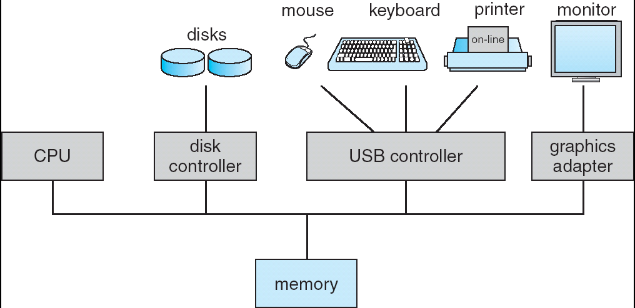
Computer System Organization
Computer-system operation
One or more CPUs, device controllers connect through common bus providing access to shared memory
Concurrent execution of CPUs and devices competing for memory cycles

Slide 11
Computer-System Operation
I/O devices and the CPU can execute concurrently.
Each device controller is in charge of a particular device type.
Each device controller has a local buffer.
CPU moves data from/to main memory to/from local buffers
I/O is from the device to local buffer of controller.
Device controller informs CPU that it has finished its operation by causing an interrupt.

Slide 12
Common Functions of Interrupts
Interrupt transfers control to the interrupt service routine generally, through the interrupt vector, which contains the addresses of all the service routines
Interrupt architecture must save the address of the interrupted instruction
A trap or exception is a software-generated interrupt caused either by an error or a user request
An operating system is interrupt driven

Slide 13
Interrupt Handling
The operating system preserves the state of the CPU by storing registers and the program counter
Determines which type of interrupt has occurred:
polling
vectored interrupt system
Separate segments of code determine what action should be taken for each type of interrupt

Slide 14
I/O Structure
After I/O starts, control returns to user program only upon I/O completion
Wait instruction idles the CPU until the next interrupt
Wait loop (contention for memory access)
At most one I/O request is outstanding at a time, no simultaneous I/O processing
After I/O starts, control returns to user program without waiting for I/O completion

Slide 15
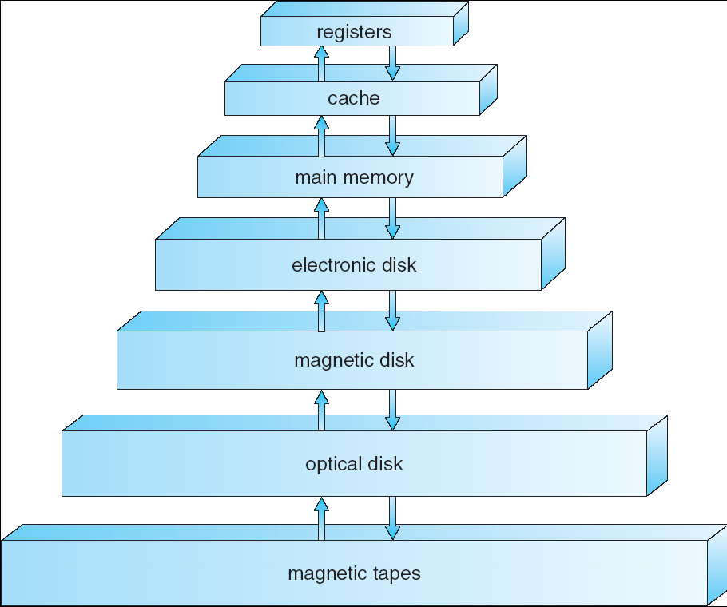
Storage-Device Hierarchy

Slide 16
Caching
Important principle, performed at many levels in a computer (in hardware, operating system, software)
Information in use copied from slower to faster storage temporarily
Faster storage (cache) checked first to determine if information is there
If it is, information used directly from the cache (fast)
If not, data copied to cache and used there
Cache smaller than storage being cached
Cache management important design problem
Cache size and replacement policy

Slide 17
Direct Memory Access Structure
Used for high-speed I/O devices able to transmit information at close to memory speeds
Device controller transfers blocks of data from buffer storage directly to main memory without CPU intervention
Only one interrupt is generated per block, rather than the one interrupt per byte

Slide 18
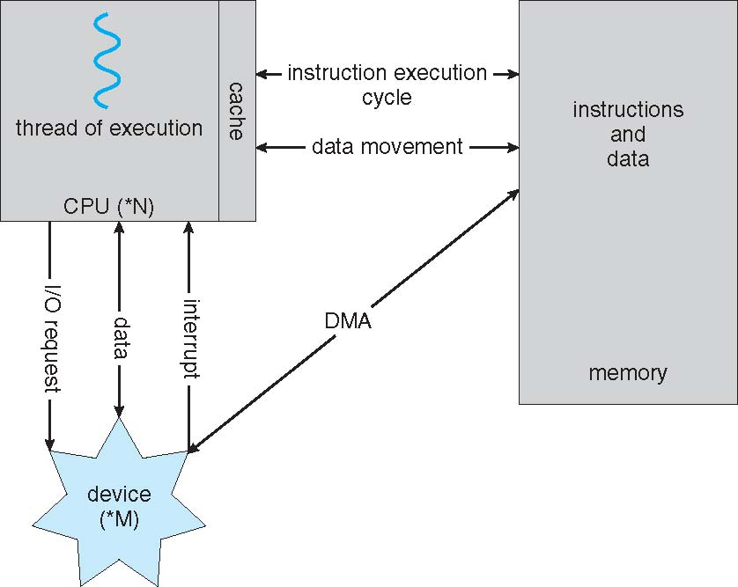
How a Modern Computer Works
A von Neumann architecture

Slide 19
Computer System Architecture

Slide 20
Computer-System Architecture
Most systems use a single general-purpose processor
Most systems have special-purpose processors as well
Multiprocessors systems growing in use and importance
Also known as parallel systems, tightly-coupled systems
Advantages include:
Increased throughput
Economy of scale
Increased reliability – graceful degradation or fault tolerance
Two types:
Asymmetric Multiprocessing – each processor is assigned a specific task.
Symmetric Multiprocessing – each processor performs all tasks

Slide 21
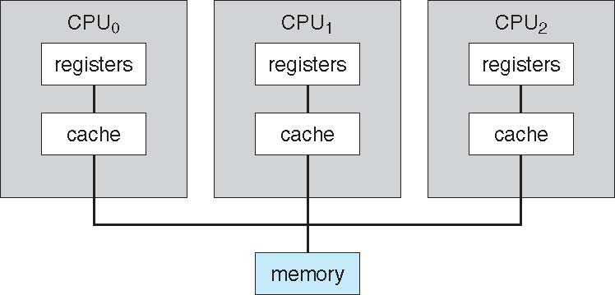
Symmetric Multiprocessing Architecture

Slide 22
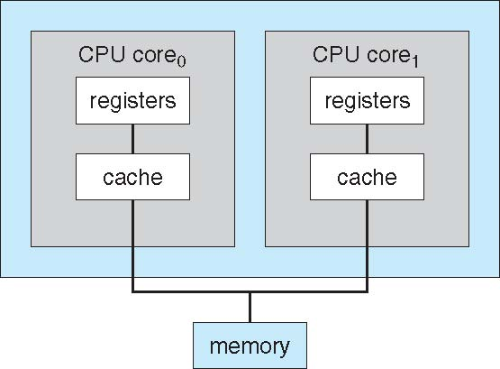
A Dual-Core Design
Multi-chip and multicore

Slide 23
Operating System Structure

Slide 24
Evolution of Operating Systems
Serial Processing
Setup included loading the compiler, source program, saving compiled program, and loading and linking
Simple Batch Systems
Monitors
Software that controls the sequence of events
Batch jobs together
Program branches back to monitor when finished

Slide 25
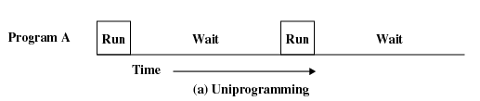
Uniprogramming
Processor must wait for I/O instruction to complete before preceding

Slide 26
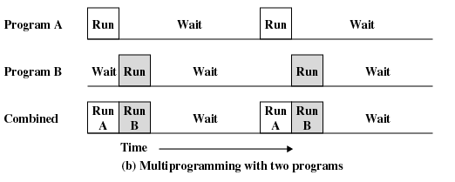
Multiprogramming
When one job needs to wait for I/O, the processor can switch to the other job

Slide 27
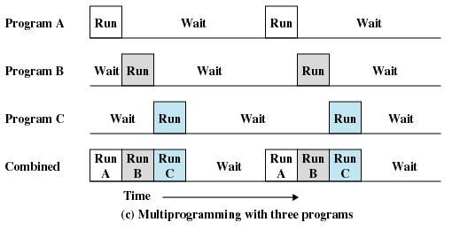
Multiprogramming

Slide 28
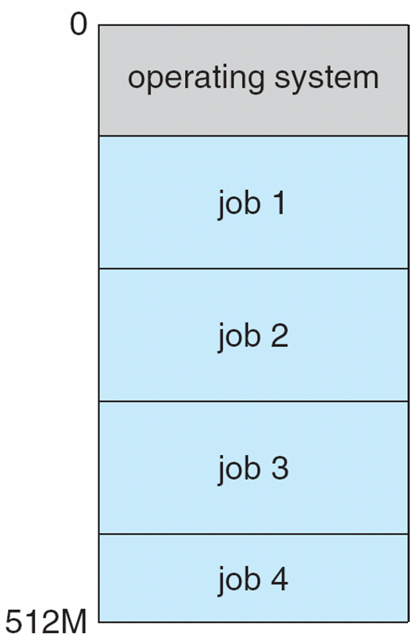
Memory Layout for Multiprogrammed System

Slide 29
Time Sharing
Processor’s time is shared among multiple users
Multiple users simultaneously access the system through terminals
Timesharing is logical extension in which CPU switches jobs so frequently that users can interact with each job while it is running, creating interactive computing
Response time should be < 1 second
Each user has at least one program executing in memory process
If several jobs ready to run at the same time  CPU scheduling
If processes don’t fit in memory, swapping moves them in and out to run
Virtual memory allows execution of processes not completely in memory

Slide 30
Multithreading
Process is divided into threads that can run concurrently
Thread
Dispatchable unit of work
executes sequentially and is interruptable
Process is a collection of one or more threads

Slide 31
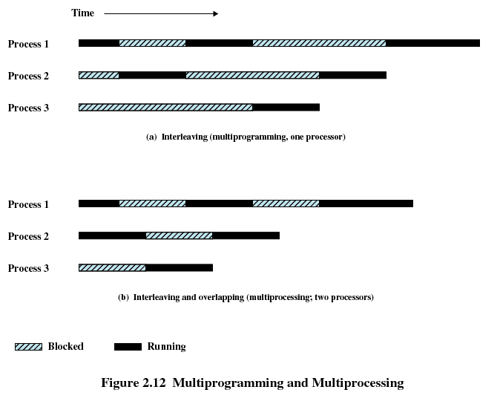
Multiprogramming and Multiprocessing

Slide 32
Operating-System Operations

Slide 33
Interrupt driven (hardware and software)
Hardware interrupt by one of the devices
Software interrupt (exception or trap):

Slide 34
Dual Mode Operations
Dual-mode operation allows OS to protect itself and other system components
User mode and kernel mode
Mode bit provided by hardware
Provides ability to distinguish when system is running user code or kernel code
Some instructions designated as privileged, only executable in kernel mode
System call changes mode to kernel, return from call resets it to user

Slide 35
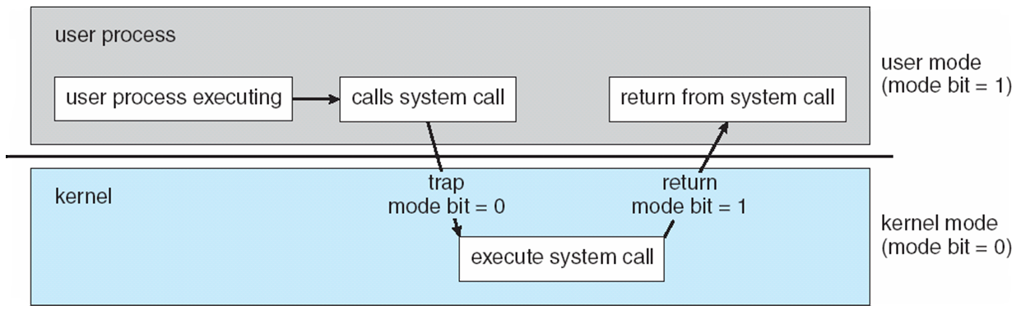
Transition from User to Kernel Mode
Timer to prevent infinite loop / process hogging resources
Timer is set to interrupt the computer after some time period
Keep a counter that is decremented by the physical clock.
Operating system set the counter (privileged instruction)
When counter zero generate an interrupt
Set up before scheduling process to regain control or terminate program that exceeds allotted time

Slide 36
OS as a Manager…
Process Management
Memory Management
Storage Management
File management
Mass Storage Management
I/O Device Management
Protection and Security

Slide 37
Process Management
A process is a program in execution. It is a unit of work within the system. Program is a passive entity, process is an active entity.
Process needs resources to accomplish its task
CPU, memory, I/O, files
Initialization data
Typically system has many processes, some user, some operating system running concurrently on one or more CPUs
Activities
Creating and deleting both user and system processes
Suspending and resuming processes
Providing mechanisms for process synchronization
Providing mechanisms for process communication
Providing mechanisms for deadlock handling

Slide 38
Memory Management
To execute a program all (or part) of the instructions must be in memory
All (or part) of the data that is needed by the program must be in memory.
Memory management determines what is in memory and when
Optimizing CPU utilization and computer response to users
Memory management activities
Keeping track of which parts of memory are currently being used and by whom
Deciding which processes (or parts thereof) and data to move into and out of memory
Allocating and deallocating memory space as needed

Slide 39
File Management
OS provides uniform, logical view of information storage
Abstracts physical properties to logical storage unit - file
Each medium is controlled by device (i.e., disk drive, tape drive)
Varying properties include access speed, capacity, data-transfer rate, access method (sequential or random)
File-System management
Files usually organized into directories
Access control on most systems to determine who can access what
OS activities include
Creating and deleting files and directories
Primitives to manipulate files and directories
Mapping files onto secondary storage
Backup files onto stable (non-volatile) storage media

Slide 40
I/O Subsystem
One purpose of OS is to hide peculiarities of hardware devices from the user
I/O subsystem responsible for
Memory management of I/O including buffering (storing data temporarily while it is being transferred), caching (storing parts of data in faster storage for performance), spooling (the overlapping of output of one job with input of other jobs)
General device-driver interface
Drivers for specific hardware devices

Slide 41
Protection and Security
Protection – any mechanism for controlling access of processes or users to resources defined by the OS
Security – defense of the system against internal and external attacks
Huge range, including denial-of-service, worms, viruses, identity theft, theft of service
Systems generally first distinguish among users, to determine who can do what
User identities (user IDs, security IDs) include name and associated number, one per user
User ID then associated with all files, processes of that user to determine access control
Group identifier (group ID) allows set of users to be defined and controls managed, then also associated with each process, file
Privilege escalation allows user to change to effective ID with more rights

Slide 42
Computing Environments

Slide 43
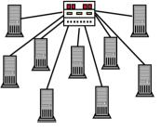
Computing Environments
Client-Server
Mobile
Peer-Peer
Web based
Distributed
Cloud
Real Time

Slide 44
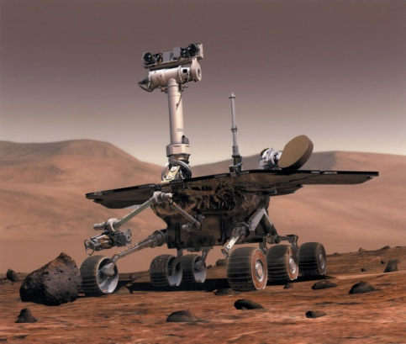
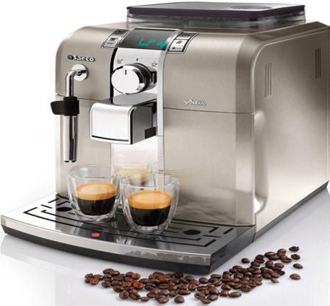
Real Time Systems
A system is a real-time system when it can support the execution of applications with time constraints on that execution
Provides quick – event response times and thus scheduling deadlines
Hard realtime system
Gurantees critical tasks to be completed on time
Missing a deadline is a total system failure.
Soft real-time system
The usefulness of a result degrades after its deadline, thereby degrading the system's quality of service.

Slide 45
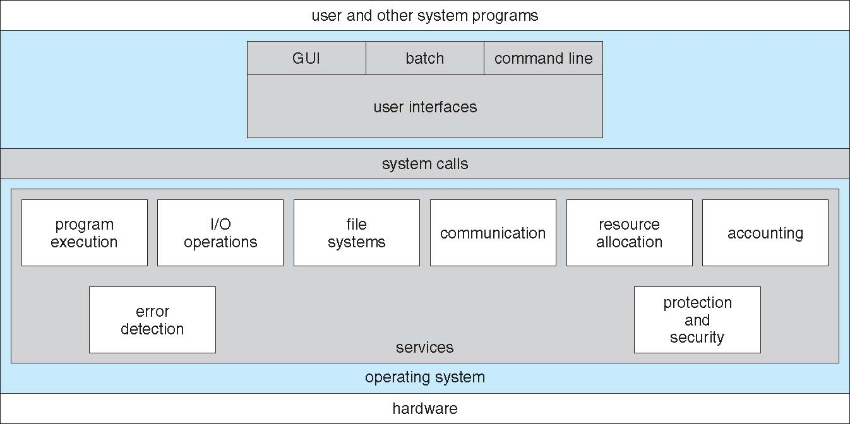
A View of Operating System Services

Slide 46
User Operating System Interface - CLI
CLI or command interpreter allows direct command entry
Sometimes implemented in kernel, sometimes by systems program
Primarily fetches a command from user and executes it
Sometimes commands built-in, sometimes just names of programs

Slide 47
User Operating System Interface - GUI
User-friendly desktop metaphor interface
Usually mouse, keyboard, and monitor
Icons represent files, programs, actions, etc
Various mouse buttons over objects in the interface cause various actions (provide information, options, execute function, open directory (known as a folder)
Many systems now include both CLI and GUI interfaces
Microsoft Windows is GUI with CLI “command” shell
Apple Mac OS X is “Aqua” GUI interface with UNIX kernel underneath and shells available
Unix and Linux have CLI with optional GUI interfaces

Slide 48
System Calls
Programming interface to the services provided by the OS
Typically written in a high-level language (C or C++)
Mostly accessed by programs via a high-level Application Programming Interface (API) rather than direct system call use
Win32 API for Windows, Java API for the Java virtual machine (JVM)

Slide 49
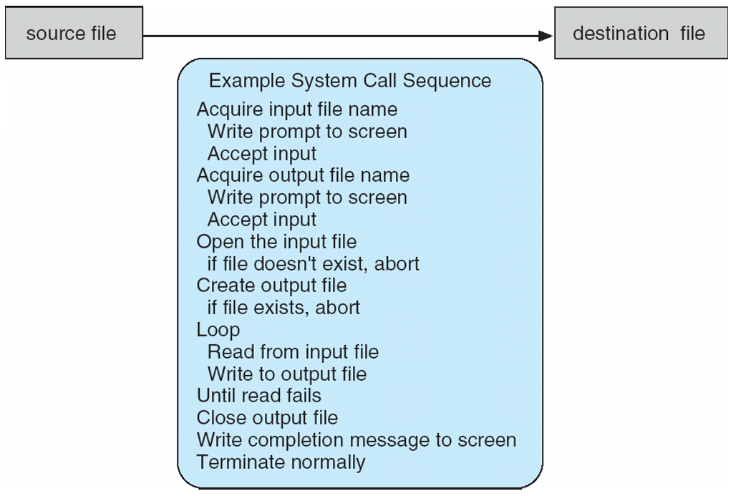
Example of System Calls
System call sequence to copy the contents of one file to another file

Slide 50
System Call Implementation
Typically, a number is associated with each system call
System-call interface maintains a table indexed according to these numbers
The system call interface invokes the intended system call in OS kernel and returns status of the system call and any return values
The caller need know nothing about how the system call is implemented
Just needs to obey API and understand what OS will do as a result call
Most details of OS interface hidden from programmer by API
Managed by run-time support library (set of functions built into libraries included with compiler)

Slide 51
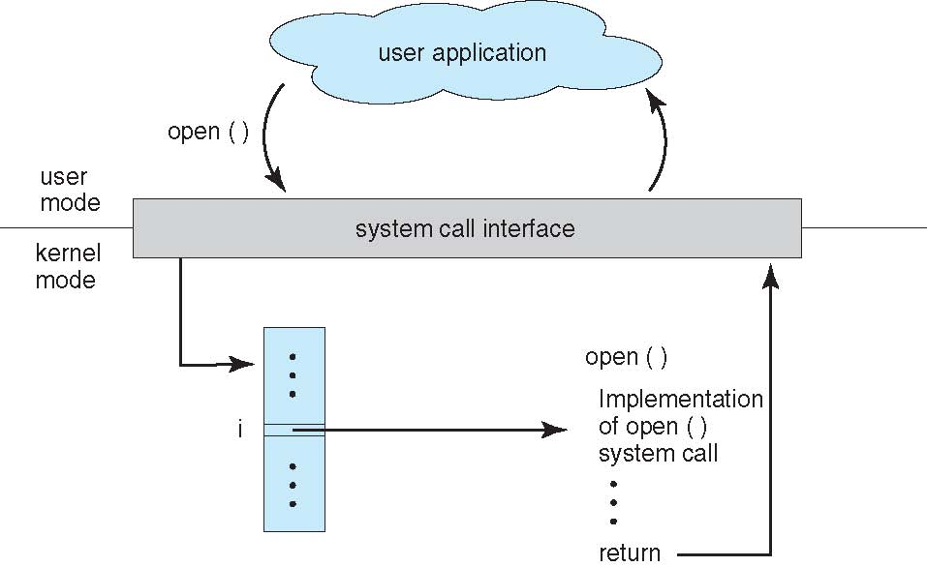
API – System Call – OS Relationship

Slide 52
Types of System Calls
Process control
create process, terminate process
end, abort
load, execute
get process attributes, set process attributes
wait for time
wait event, signal event
allocate and free memory
Dump memory if error
Debugger for determining bugs, single step execution
Locks for managing access to shared data between processes

Slide 53
Types of System Calls
File management
create file, delete file
open, close file
read, write, reposition
get and set file attributes
Device management
request device, release device
read, write, reposition
get device attributes, set device attributes
logically attach or detach devices

Slide 54
Types of System Calls (Cont.)
Information maintenance
get time or date, set time or date
get system data, set system data
get and set process, file, or device attributes
Communications
create, delete communication connection
send, receive messages if message passing model to host name or process name
From client to server
Shared-memory model create and gain access to memory regions
transfer status information
attach and detach remote devices

Slide 55
Types of System Calls (Cont.)
Protection
Control access to resources
Get and set permissions
Allow and deny user access

Slide 56
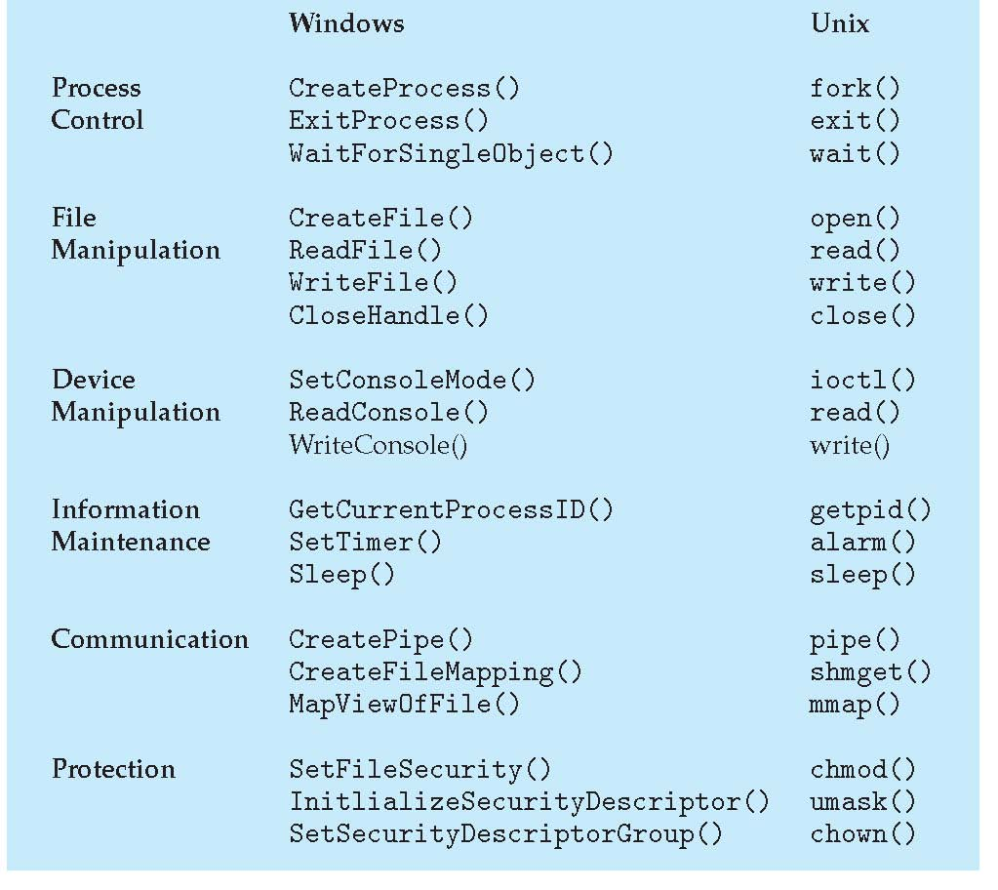
Examples of Windows and Unix System Calls

Slide 57
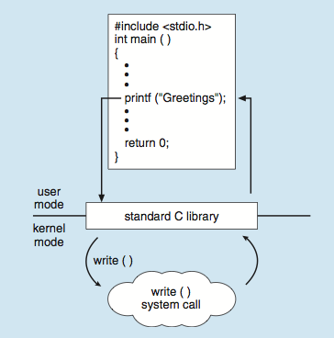
Standard C Library Example
C program invoking printf() library call, which calls write() system call

Slide 58
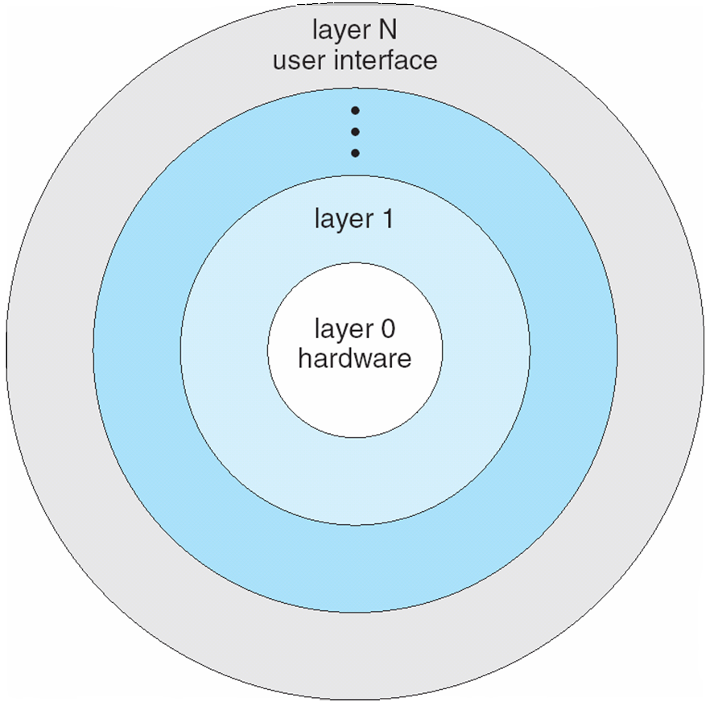
Layered Approach
The operating system is divided into a number of layers (levels), each built on top of lower layers. The bottom layer (layer 0), is the hardware; the highest (layer N) is the user interface.
With modularity, layers are selected such that each uses functions (operations) and services of only lower-level layers

